Slide 1
Titanic survival prediction
Saffian Asghar
Emilio Espinosa Sanchez

Slide 2
Agenda
The RMS Titanic was a British passenger liner that sank in the North Atlantic Ocean in the early morning hours of 15 April 1912
There were an estimated 2,224 passengers and crew aboard the ship, and more than 1,500 died
Let’s see if we can use Artificial Intelligence to predict if a passenger will survive

Slide 3
Workflow
EDA
Analyze the data, filter significant attributes, substitute missing values
Build features & categories
Analyze key features and build new ones for prediction
model
Select and build suitable models depending upon your data
Train, test & compare
Train your model and test it with an unseen sample.
Compare different models results and accuracy

Slide 4
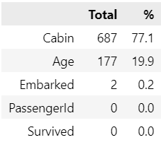
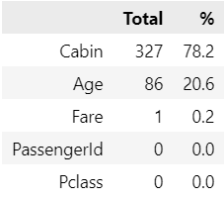
eda
Missing Values
Cabin
Take character of cabin and substitute X for all missing values
Age
Compute the mean across groups of passenger class and substitute for missing values
Training Data
Embarked
Fill in missing values with the mode
Fare
Fill in missing values with mean with respect to its passenger class
Testing Data

Slide 5
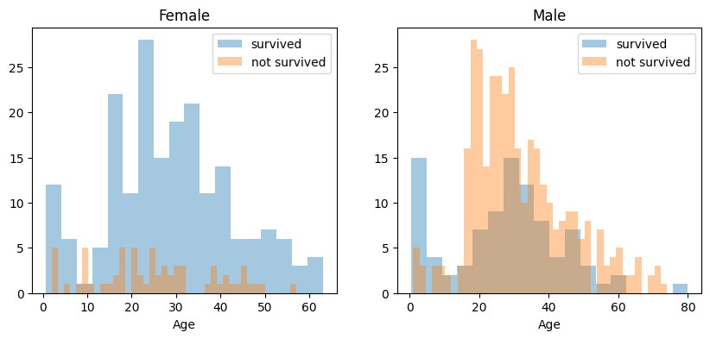
eda
Survival - Gender

Slide 6
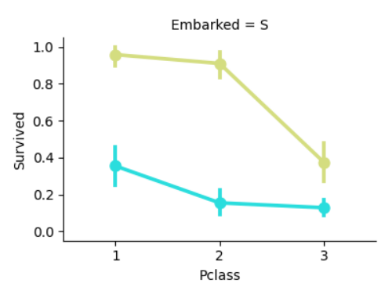
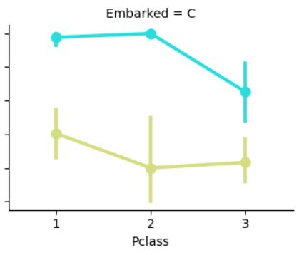
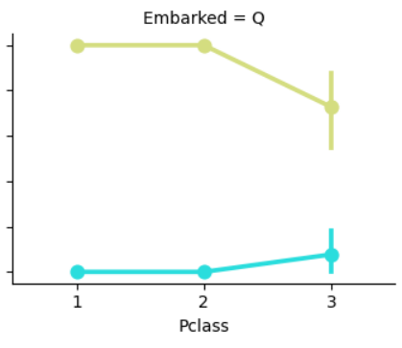
eda
Survival relation with the place of embarkment and passenger class

Slide 7
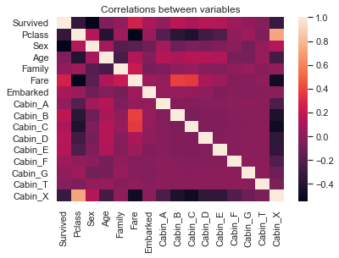
eda
Correlation

Slide 8
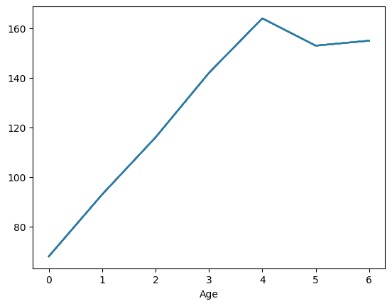
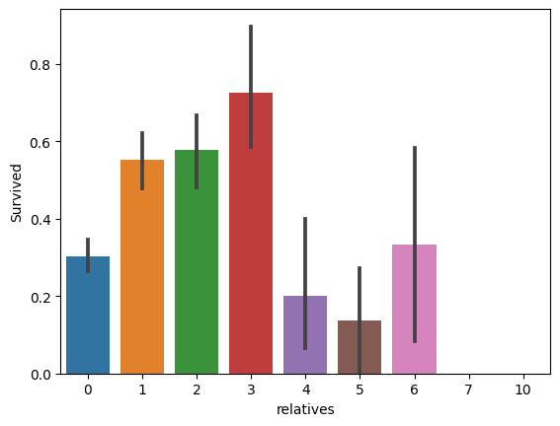
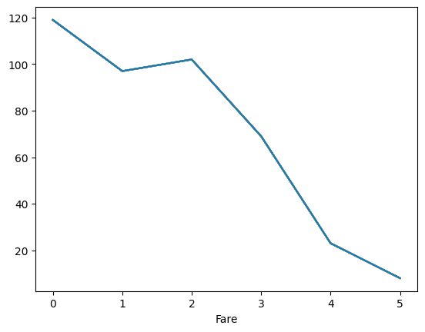
Building categories
Age
Categorize age groups with respect to data (Avoid empty bins)
Convert each bin to numerical value
Travelling with family
Check if a passenger is traveling with family or not
With Family 537
Alone 354
Fare
Categorize with a similar approach as in age
Convert each bin to a numerical value

Slide 9
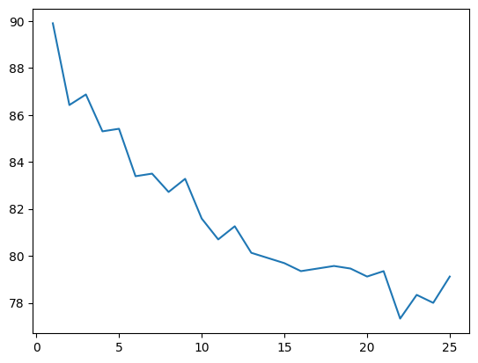
K nearest neighbor
Selecting optimal value for k
Check for different values of k to analyze the performance of KNN for the given dataset
For k = 1, we are getting the highest value of the accuracy score
A general rule of thumb is to set k = sqrt(n)/2 where n is the number of samples
We selected k = 5 to avoid overfitting the model

Slide 10

K nearest neighbor
Cross Validation
Check for different values of k to analyze the performance of KNN for the given dataset using cross validation, we used 5 folds for parameter cv
For k = 5 we observed the highest accuracy

Slide 11
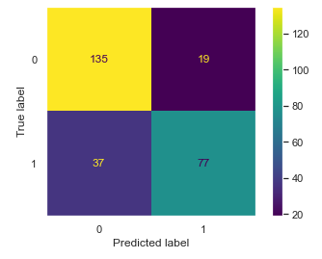
Logistic regression
Maximum likelihood probability
Logistic regression uses ‘maximum likelihood’ to fit the best line to the data.
0 : Casualty 1: Survived

Slide 12
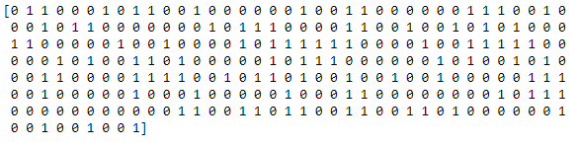
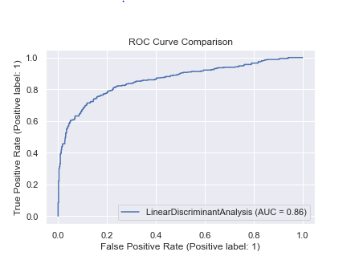
Discriminant analysis

Slide 13
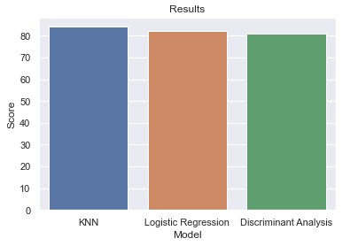
Performance
KNN is the most accurate model.
With all features used in cleaned data

Slide 14
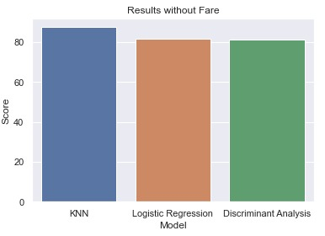
Performance
KNN is the most accurate model.
With all features except Fare

Slide 15
THANK YOU
Saffian
Emilio

